Slide 1


SR
18 July 2023

Slide 2

Outline
Executive Summary
Introduction
Methodology
Results
Conclusion
Appendix

Slide 3
Executive Summary
Data from scraping Wikipedia and SpaceX REST API
Data exploration: plotting, SQL queries, plotly dashboard
Prediction: grid search for logistic regression, SVM, decision tree, k-means

Slide 4
Introduction
The company SpaceX develops rockets
Test launches happen at various launch sites, with varying payloads / boosters / etc.
Goal: Predict success of future launch based on previous launches & accessible parameters

Slide 5

Section 1

Slide 6
Methodology
Executive Summary
Data collection methodology:
Webscraping Falcon Wikipedia page + SpaceX REST API
Perform data wrangling
Pandas dataframe / SQL DB, feature generation, standardization
Perform exploratory data analysis (EDA) using visualization and SQL
Perform interactive visual analytics using Folium and Plotly Dash
Perform predictive analysis using classification models
How to build, tune, evaluate classification models

Slide 7
Data Collection
ApaceX REST API
make request according to api specification
get JSON -> parse json -> insert into dataframe
Webscraping
load page -> process with beautiful soup -> find table in DOM
parse with custom loop or pandas -> make dataframe

Slide 8
Data Collection – SpaceX API
/launches/past
rocket_id, payload_id, launchpad_id, {core_id},flight_number, date_utc
/rockets/<id>
BoosterVersion
/launchpads/<id>
Longitude, Latitude, LaunchSite
/payloads/<id>
/cores/<id>
PayloadMass, Orbit
Block, ReusedCount, Serial, Outcome, Flights, GridFins, Reused, Legs, LandingPad
https://api.spacexdata.com/v4/*
1) Get history of launches
2) Get further info for various occurring IDs
https://github.com/s3bru/ibm_capstone/blob/main/1_jupyter-labs-spacex-data-collection-api.ipynb

Slide 9
Data Collection - Scraping
requests.get(url)
BeautifulSoup
soup.find_all("table")
Iterate rows->fill dict
dataframe
Download the page ” List_of_Falcon_9_and_Falcon_Heavy_launches” from wikipedia
Process with beautiful soup
Find table in DOM
Iterate rows, extract info, put in dicts
Make pandas dataframe
https://github.com/s3bru/ibm_capstone/blob/main/1_jupyter-labs-webscraping.ipynb

Slide 10
Data Wrangling
Calculate the number and occurence of mission outcome per orbit type
Create a landing outcome label from Outcome column
https://github.com/s3bru/ibm_capstone/blob/main/1_labs-jupyter-spacex-data_wrangling_jupyterlite.jupyterlite.ipynb

Slide 11
EDA with Data Visualization
Scatter: FlightNumber - PayloadMass & hue==class
Scatter: FlightNumber - LaunchSite & hue==class
Scatter: PayloadMass - LaunchSite & hue==class
Bar: Sucess_rate – Orbit type
Scatter: FlightNumber - Orbit type & hue==class
Scatter: Payload - Orbit type & hue==class
Line: Year - Sucess_rate
Add the GitHub URL of your completed EDA with data visualization notebook, as an external reference and peer-review purpose

Slide 12
EDA with SQL: Queries 1
names of unique launch sites
launch sites beginning with the string 'CCA‘
total payload mass carried by boosters launched by NASA (CRS)
average payload mass carried by booster version F9 v1.1
date when first successful landing in ground pad was achieved
names of boosters with success in drone ship and payload mass between 4000 and 6000

Slide 13
EDA with SQL: Queries 2
total number of successful /failure mission outcomes
names of booster_versions which have carried the maximum payload mass
month names, failure landing_outcomes in drone ship ,booster versions, launch_site for all months in year 2015
Ranking of count of landing outcomes between 2010-06-04 and 2017-03-20

Slide 14
Build an Interactive Map with Folium
Markers + labels + circle for nasa JSC + launch sites (relevant locations)
MarkerClusters containing launches (suc./fail) for each launch site (overview of relevant events)
Mouse position -> cords (find coords of things in vicinity)
Marker + line to closest point of coast line, railway, city and highway
(water -> lower risk of endangerment <-> railway / city / highway -> could be endangered)
https://github.com/s3bru/ibm_capstone/blob/main/3_lab_jupyter_launch_site_location.jupyterlite.ipynb

Slide 15
Build a Dashboard with Plotly Dash
Inputs: Dropdown launch sites + Slider payload range
Graphs:
Pie chart: either total succ. per launch site or succ&fail for selected launch site -> comparison of outcomes for all / specific LS
Scatter chart: payload – launch success -> shows correlation (for selected inputs)
https://github.com/s3bru/ibm_capstone/blob/main/3_spacex_dash_app.py

Slide 16
Predictive Analysis (Classification)
Standardize feature data
Split data in train / test sets
Perform parameter grid search for
Logistic regression / SVM / decision tree / KNN
Display confusion matrix / accuracy score for best parameters (test set)
Pick best performing model
https://github.com/s3bru/ibm_capstone/blob/main/4_SpaceX_Machine_Learning_Prediction_Part_5.jupyterlite.ipynb

Slide 17
Results
Exploratory data analysis results
Interactive analytics demo in screenshots
Predictive analysis results

Slide 18

Section 2

Slide 19
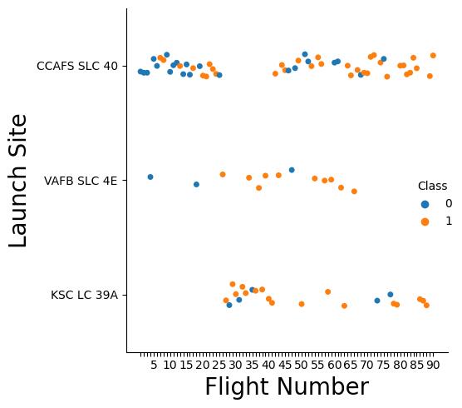
Flight Number vs. Launch Site
Launches at VAFB mostly successful
At CCAFS rate increases with flight number

Slide 20
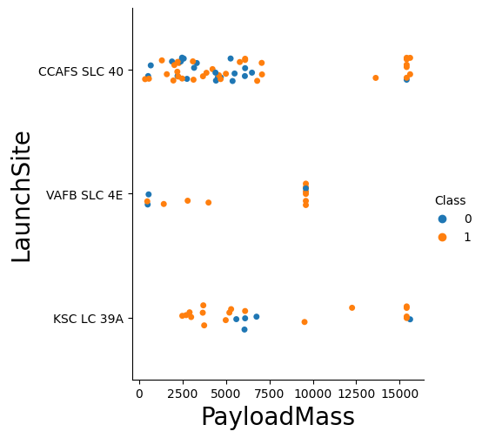
Payload vs. Launch Site
KSC fail for mid level payload
CCAFS low correlation, success for high payload
VAFB fail for low payload

Slide 21
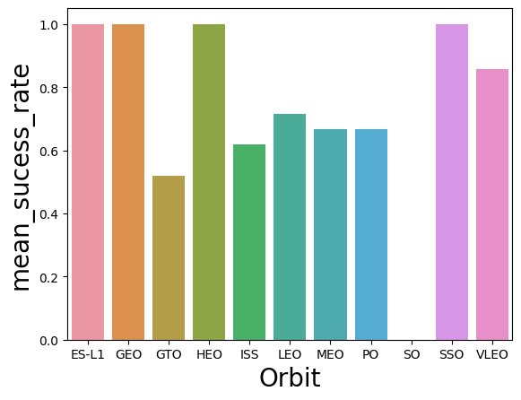
Success Rate vs. Orbit Type
All launches were successful for ES-L1, GEO, HEO, SSO
Lowest success rate for GTO

Slide 22
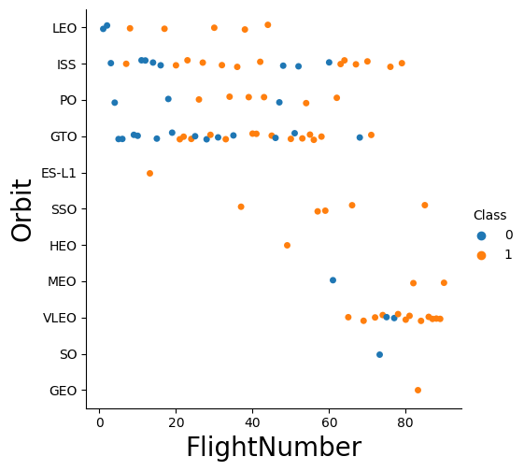
Flight Number vs. Orbit Type
Low Flight Number : LEO, ISS, PO, GTO
First fail then more succ.
SSO always succ.
Many VLEO attempts, only 2x fail in middle
Geo succ. at first try

Slide 23
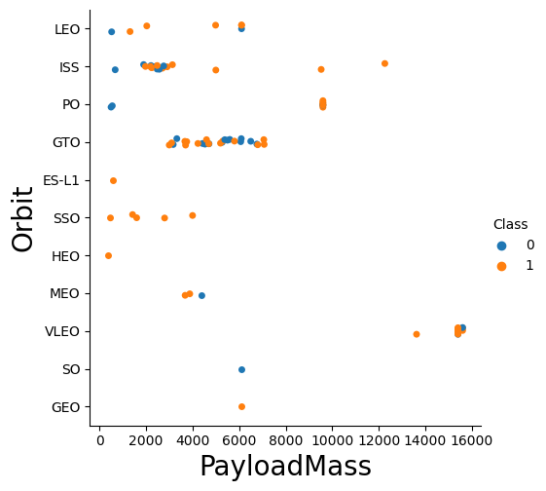
Payload vs. Orbit Type
LEO, ISS, PO fail with low payload
GTO uncorrelated

Slide 24
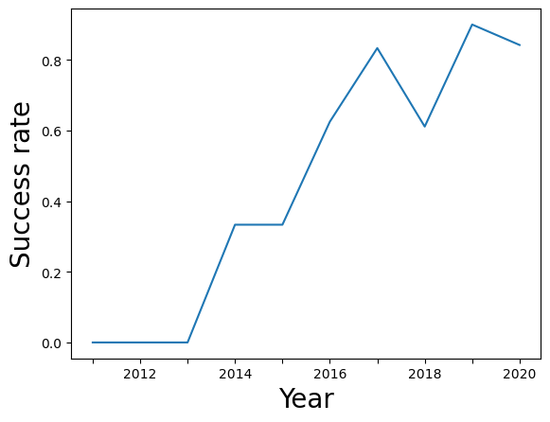
Launch Success Yearly Trend
Success rate yearly increase except for 2018!

Slide 25
All Launch Site Names
SQL: Select distinct(Launch_Site) from SPACEXTBL
-> ['CCAFS LC-40', 'VAFB SLC-4E', 'KSC LC-39A', 'CCAFS SLC-40', None]
None -> incomplete data

Slide 26
Launch Site Names Begin with 'CCA'
SQL:Select * from SPACEXTBL where Launch_Site like"CCA%" limit 5
-> [('06/04/2010', '18:45:00', 'F9 v1.0 B0003', 'CCAFS LC-40', 'Dragon Spacecraft Qualification Unit', 0.0, 'LEO', 'SpaceX', 'Success', 'Failure (parachute)'),
('12/08/2010', '15:43:00', 'F9 v1.0 B0004', 'CCAFS LC-40', 'Dragon demo flight C1, two CubeSats, barrel of Brouere cheese', 0.0, 'LEO (ISS)', 'NASA (COTS) NRO', 'Success', 'Failure (parachute)'),
('22/05/2012', '7:44:00', 'F9 v1.0 B0005', 'CCAFS LC-40', 'Dragon demo flight C2', 525.0, 'LEO (ISS)', 'NASA (COTS)', 'Success', 'No attempt'),
('10/08/2012', '0:35:00', 'F9 v1.0 B0006', 'CCAFS LC-40', 'SpaceX CRS-1', 500.0, 'LEO (ISS)',
'NASA (CRS)', 'Success', 'No attempt'), ('03/01/2013', '15:10:00', 'F9 v1.0 B0007', 'CCAFS LC-40', 'SpaceX CRS-2', 677.0, 'LEO (ISS)', 'NASA (CRS)', 'Success', 'No attempt')]

Slide 27
Total Payload Mass
SQL: Select PAYLOAD_MASS__KG_ from SPACEXTBL where Customer like "NASA (CRS)%"
-> 48213.0

Slide 28
Average Payload Mass by F9 v1.1
SQL: Select PAYLOAD_MASS__KG_ from SPACEXTBL where Booster_Version like "F9 v1.0%"
-> 340.4

Slide 29
First Successful Ground Landing Date
SQL: Select min(Date) from SPACEXTBL where Landing_Outcome = "Success (ground pad)“
->[('01/08/2018',)]

Slide 30
Successful Drone Ship Landing with Payload between 4000 and 6000
SQL: Select Booster_Version from SPACEXTBL where Landing_Outcome = \"Success (drone ship)\" and PAYLOAD_MASS__KG_ between 4000 and 6000
->[('F9 FT B1022',), ('F9 FT B1026',), ('F9 FT B1021.2',), ('F9 FT B1031.2',)]

Slide 31
Total Number of Successful and Failure Mission Outcomes
SQL: Select Landing_Outcome from SPACEXTBL where Landing_Outcome like "Success%“
->61
SQL: Select Landing_Outcome from SPACEXTBL where Landing_Outcome like "Failure%“
->10

Slide 32
Boosters Carried Maximum Payload
SQL: Select Booster_Version from SPACEXTBL where PAYLOAD_MASS__KG_ = (select max(PAYLOAD_MASS__KG_) from SPACEXTBL)
->|F9 B5 B1048.4| |F9 B5 B1049.4| |F9 B5 B1051.3| |F9 B5 B1056.4| |F9 B5 B1048.5| |F9 B5 B1051.4| |F9 B5 B1049.5| |F9 B5 B1060.2 | |F9 B5 B1058.3 | |F9 B5 B1051.6| |F9 B5 B1060.3| |F9 B5 B1049.7 |

Slide 33
2015 Launch Records
SQL: Select substr(Date, 4, 2),Landing_Outcome,Booster_Version,Launch_Site from SPACEXTBL where Landing_Outcome= "Failure (drone ship)"and substr(Date,7,4)='2015'
->|('10', 'Failure (drone ship)', 'F9 v1.1 B1012', 'CCAFS LC-40')| |('04', 'Failure (drone ship)', 'F9 v1.1 B1015', 'CCAFS LC-40')|

Slide 34
Rank Landing Outcomes Between 2010-06-04 and 2017-03-20
SQL: Select count(*),Landing_Outcome from SPACEXTBL group by Landing_Outcome order by count(*) desc
->[(898, None), (38, 'Success'), (21, 'No attempt'), (14, 'Success (drone ship)'), (9, 'Success (ground pad)'), (5, 'Failure (drone ship)'), (5, 'Controlled (ocean)'), (3, 'Failure'), (2, 'Uncontrolled (ocean)'), (2, 'Failure (parachute)'), (1, 'Precluded (drone ship)'), (1, 'No attempt ')]

Slide 35

Section 3

Slide 36
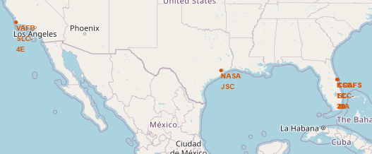
Folium: Launch sites
Markers for JSC + launch sites
VAFB at west coast, others east coast(grouped very closely)

Slide 37
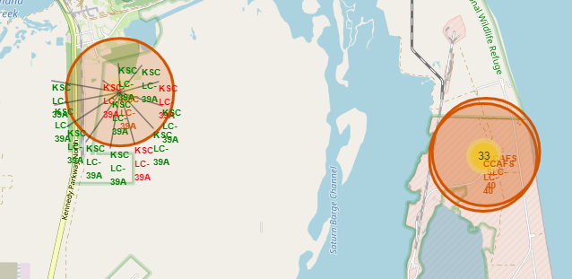
Folium: Launch events
For each launch site: show color coded(succ.=green) launch events

Slide 38
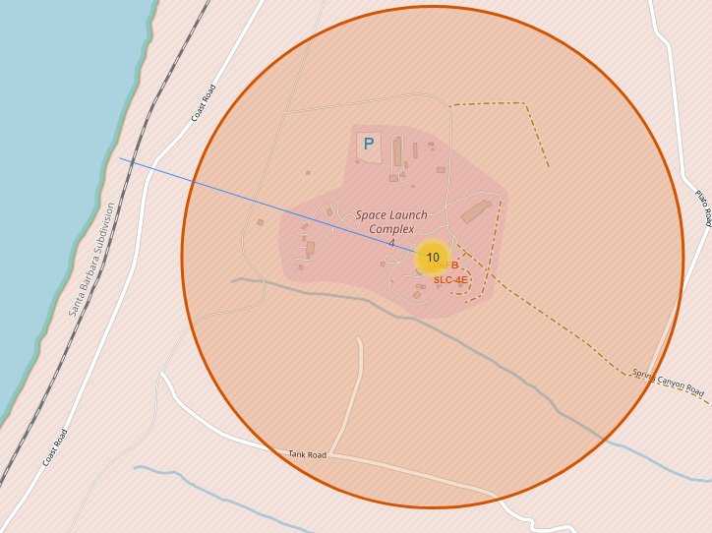
Folium: Launch site proximities
Distance to coastline marked(d=1.31 km)
Railroad can be seen near coast

Slide 39

Section 4

Slide 40
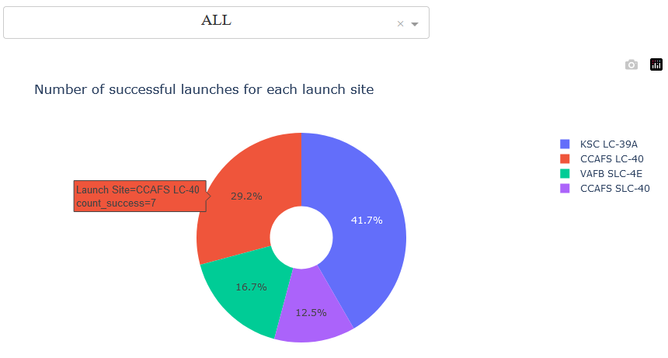
Piechart 1
Values==successful launches for each site

Slide 41
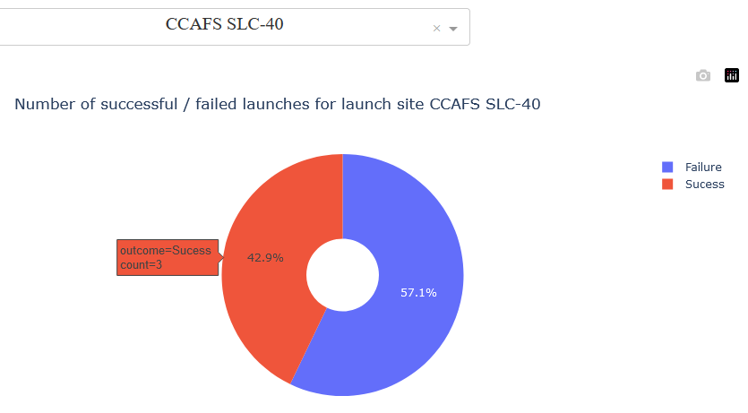
Piechart 2
Dropdown field selects launch site
Values==count of succ./ fail for selected launch site

Slide 42
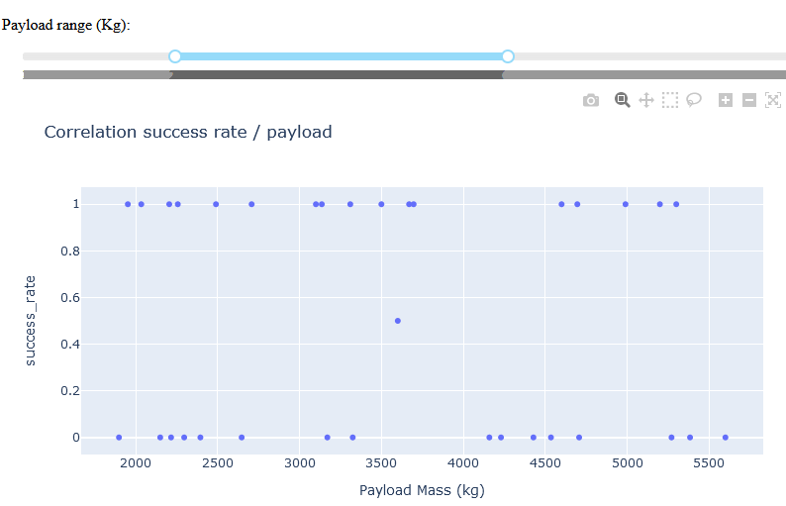
Scatterplot
Slider selects range for payload mass
Dropdown selects which launch sites are considered
Scatter plot for success rate / payload mass

Slide 43

Section 5

Slide 44
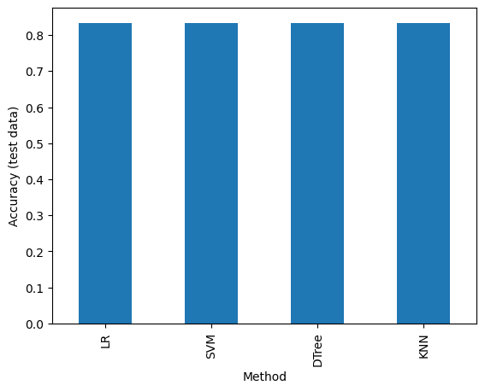
Classification Accuracy
For the given dataset and train/test split, the optimized models perform with equal accuracy well on the test data

Slide 45

Confusion Matrix
Shows counts of predicted labels for each category of the true label
For the test set 3 times a successful landing was predicted falsely

Slide 46
Conclusions
It’s possible to predict successful landings with 84 % accuracy from data on wiki / SpaceX rest

Slide 47
Appendix
https://github.com/s3bru/ibm_capstone
https://github.com/s3bru/ibm_capstone/blob/main/2_IBM-DS0321EN-SkillsNetwork_labs_module_2_jupyter-labs-eda-dataviz.ipynb.jupyterlite.ipynb
https://github.com/s3bru/ibm_capstone/blob/main/2_jupyter-labs-eda-sql-coursera_sqllite.ipynb
https://github.com/s3bru/ibm_capstone/blob/main/spacex_launch_dash.csv

Slide 48


